Slide 1

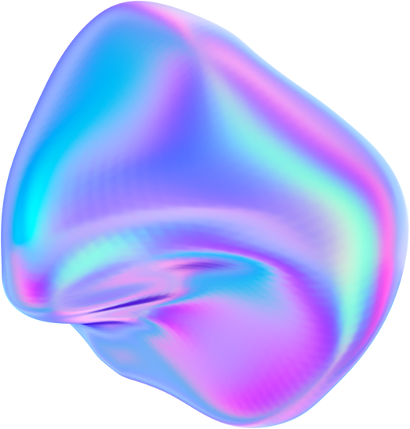


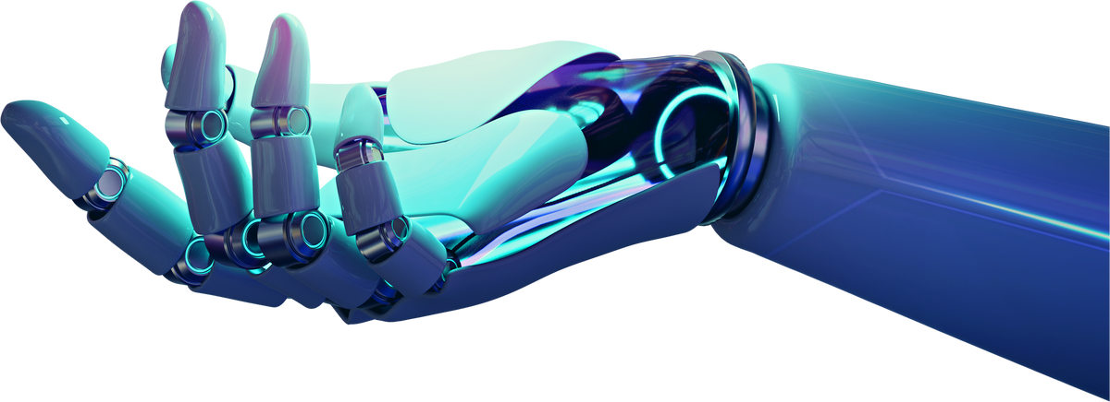



AI in Genomics and Personalized Medicine
Rod Geryk C. Navarro
CPE161P-4_C1

Slide 2




Introduction
The crossroads of healthcare evolution, where genomics and Al unite to deliver personalized medicine through precise diagnostics and tailored treatments.
Definition of Personalized Medicine: Tailoring medical treatment to individual characteristics, including genetic makeup, environment, and lifestyle.
Role of AI: Processing extensive patient data to create personalized treatment plans.

Slide 3
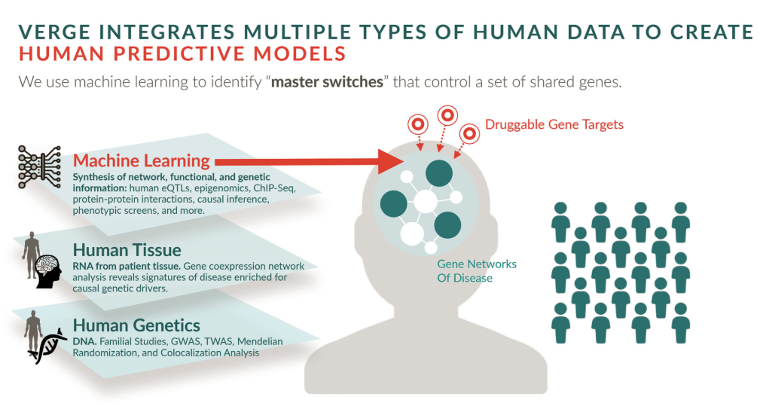
Precision medicine is a revolutionary approach to healthcare that tailors medical treatment and interventions to individual patients based on their unique genetic makeup, environmental factors, lifestyle choices, and other relevant data.

Slide 4

By leveraging the power of genomics and Al, precision medicine aims to improve diagnostic accuracy, treatment effectiveness, and overall patient outcomes.
This comprehensive exploration delves into the intricate interplay between genomics and Al in enabling personalized healthcare, highlighting their applications, challenges, ethical considerations, and potential, future developments.

Slide 5



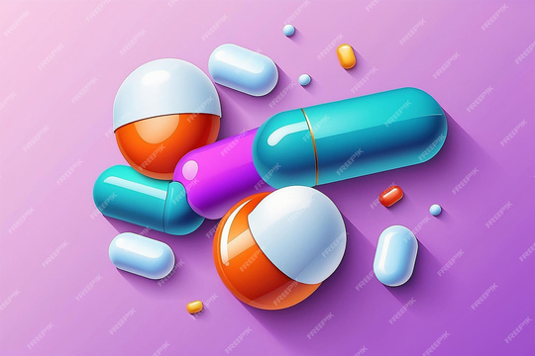
Product 2
AI in Drug Discovery and Development
Accelerating drug discovery through AI
Predicting drug efficacy and toxicity
Real-time monitoring and feedback
Identifying potential drug targets using AI
Case studies of AI in pharmaceutical research
Challenges and future directions in AI-driven drug development
Human AI collaboration

Slide 6

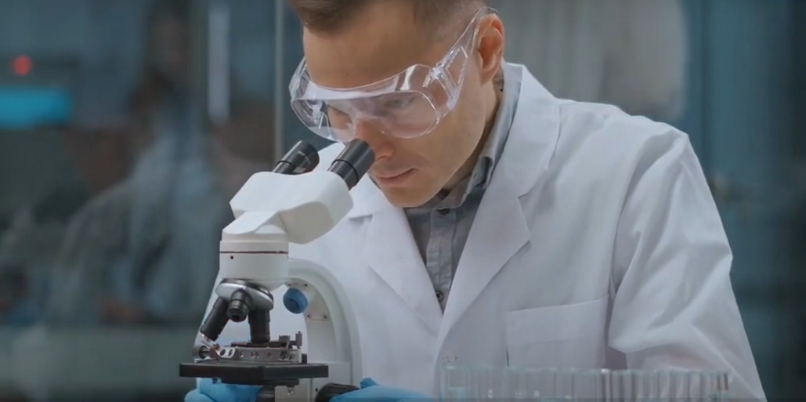
What is Genomics?
The human genome consists of around 20,000-25,000 genes that encode the instructions for building and maintaining the human body
Genomics, the study of an individual’s complete set of genetic material, has been a cornerstone in enabling precision medicine.
By analyzing an individual's genome, healthcare professionals can identify genetic variations, mutations, and markers that contribute to disease susceptibility, drug response, and other health-related factors.

Slide 7

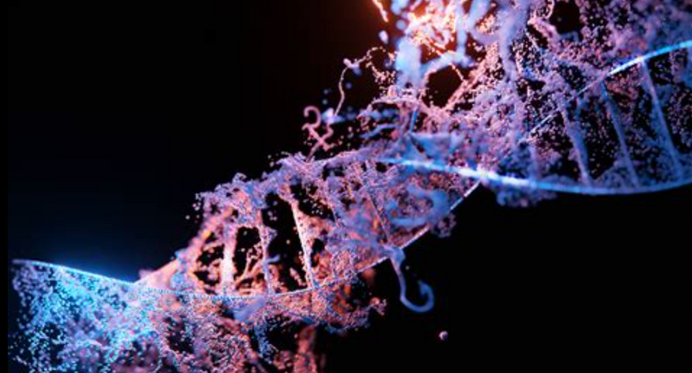
The Intersection of AI and Genomics
How AI processes large-scale genomic data.
Machine learning algorithms in identifying genetic patterns.
AI's role in predicting gene expression and function.
Case studies demonstrating AI applications in genomics.
Challenges in AI-driven genomic analysis

Slide 8

Challenges in Integrating AI into Genomics
Technical challenges in data integration
Interpreting AI-generated insights
Scalability issues in AI applications
Overcoming resistance to AI adoption in clinical settings
Potential solutions and ongoing research

Slide 9
Future Directions and Innovations
Emerging trends in AI and genomics
Innovations in AI algorithms for better accuracy
Potential of AI in gene editing technologies
Collaborations between AI and genomics researchers
Long-term vision for AI in personalized medicine
CONCLUSION
Artificial Intelligence (AI) is significantly transforming genomics and personalized medicine, offering promising solutions for more accurate diagnostics and tailored treatments. By analyzing complex genetic data, AI is helping predict disease risks, create personalized treatment plans, and even speed up drug discovery. However, challenges such as data privacy, ethical concerns, and the integration of AI into clinical settings remain. Despite these hurdles, AI is paving the way for a future where healthcare is more personalized and precise. As AI continues to evolve, its potential in improving patient outcomes and advancing scientific research grows, leading us toward a future of healthcare that is not only more efficient but also more accessible and effective for everyone.

Slide 10
References:
https://us.sganalytics.com/blog/role-of-artificial-intelligence-machine-learning-in-genomics/
https://www.genengnews.com/insights/ai-transforms-genomic-data-into-actionable-insights/
https://pmc.ncbi.nlm.nih.gov/articles/PMC10617817/?utm_source=chatgpt.com
https://pmc.ncbi.nlm.nih.gov/articles/PMC7580505/?utm_source=chatgpt.com
https://www.news-medical.net/health/AI-Powered-Genomic-Analysis-Revolutionizing-the-Detection-of-Genetic-Mutations.aspx?utm_source=chatgpt.com
https://www.laboratoriosrubio.com/en/ai-personalized-medicine/?utm_source=chatgpt.com
https://youtu.be/NHszJiL-9pM?si=Z5uEWCLtTIDjPg1K

